Slide 1
Versailles
Le palais des rois
Rick Steves

Slide 2

Versailles today is known as one of the most luxurious and historic places in the world, and certainly in France.
An estimated 15 million people visit it every year. They walk the gardens, see the Hall of Mirrors, The king’s bedroom that faces the rising sun, Marie Antoinette’s small private home.

Slide 3
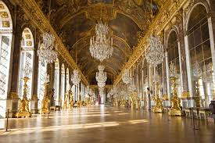
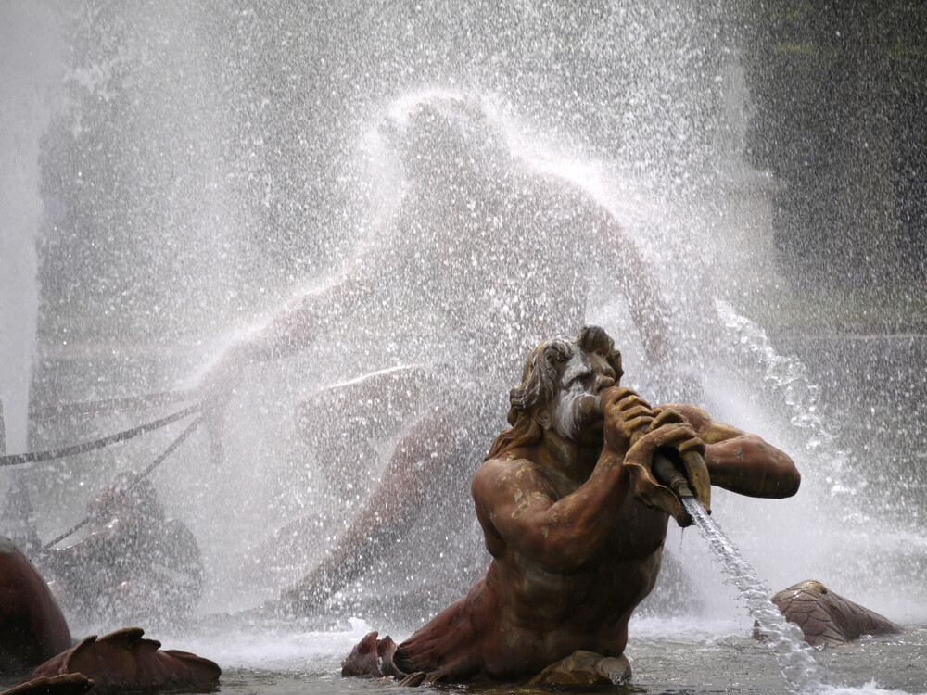
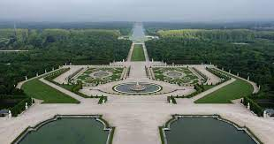
The hall of mirrors and the grands jardins

Slide 4
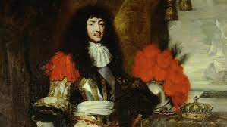
One of the first Monarchs(rulers) of France was King Louis XIV(14th). He called himself The Sun King, or Le Roi Soleil.
He ruled from 1643-1715

Slide 5
Right now we are going to watch a 7 minute video about Versailles. You will learn more about it’s history and importance in French culture, and WHY it went from a small hunting cottage to it’s massive size.
Then you will answer some comprehension questions about it to assess what you learned.
On y va!!!!
Rick Steves Versailles

Slide 6
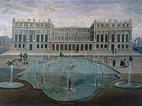
While Versailles started as the Royal family hunting lodge of Louis XIII, it soon became what?
Notes:
🍐 This is a Pear Deck Multiple Choice Slide. Your current options are: A: The seat of the Royal Government, B: A home for poor nobles and farmers, C: The central government of all Europe.,
🍐 To edit the type of question or choices, go back to the "Ask Students a Question" in the Pear Deck sidebar.

Slide 7
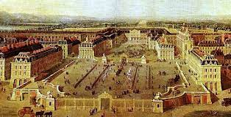
Where did King Louis live while he was ruling France?
Notes:
🍐 This is a Pear Deck Multiple Choice Slide. Your current options are: A: Paris, B: London, C: Versailles,
🍐 To edit the type of question or choices, go back to the "Ask Students a Question" in the Pear Deck sidebar.

Slide 8
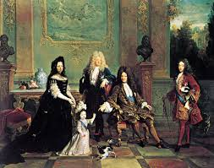
What did the the King do to France’s various regional kingdoms and governments?
Notes:
🍐 This is a Pear Deck Multiple Choice Slide. Your current options are: A: Nothing, he let them keep going as is., B: He started wars with them all to see who would rule France., C: He took control of all government and centralized it at Versailles,
🍐 To edit the type of question or choices, go back to the "Ask Students a Question" in the Pear Deck sidebar.

Slide 9
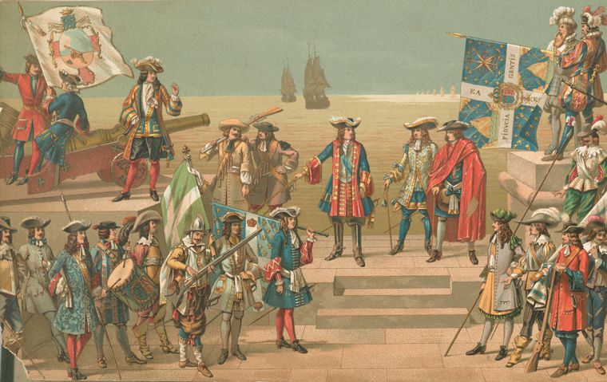
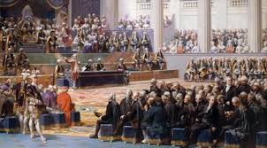
Politics, culture, theatre, language, clothes and music were all examples of France’s what in the late 1600’s?

Slide 10

The King was inspired by Apollo. What was king Louis XIV’s nickname, as represented by this image? Hint in French it is “Le Roi Soleil”.
You may also see a few symbols of the Kings
Of France.
Notes:
🍐 This is a Pear Deck Text Slide
🍐 To edit the type of question, go back to the "Ask Students a Question" in the Pear Deck sidebar.

Slide 11
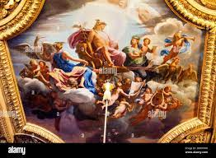
In the video, you heard Rick say that King Louis and his government became “absolute monarchs”, and essentially brought all of France under his rule. How did the family see themselves, as shown in this painting.
Notes:
🍐 This is a Pear Deck Multiple Choice Slide. Your current options are: A: As Gods, B: As normal people, C: As Immortal,
🍐 To edit the type of question or choices, go back to the "Ask Students a Question" in the Pear Deck sidebar.

Slide 12

He had a special saying in thinking about how he saw his rule and his importance in France, which was “L’etat, c’est moi”.
What does this mean?
Notes:
🍐 This is a Pear Deck Text Slide
🍐 To edit the type of question, go back to the "Ask Students a Question" in the Pear Deck sidebar.

Slide 13
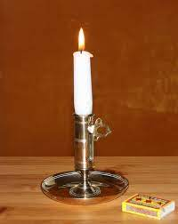
One of the most important roles of all the advisors the king was to take part in this daily ritual. Which included holding a candle so the king could see himself do what?
Notes:
🍐 This is a Pear Deck Multiple Choice Slide. Your current options are: A: Eat his scrumptous dinners., B: Get ready for bed, C: Plan out military raids on neighbors, D: Count the money he stole from other kings.,
🍐 To edit the type of question or choices, go back to the "Ask Students a Question" in the Pear Deck sidebar.

Slide 14
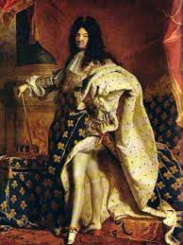
Draw me your interpretation of Le Roi Soleil.
Notes:
🍐 This is a Pear Deck Drawing Slide
🍐 To edit the type of question, go back to the "Ask Students a Question" in the Pear Deck sidebar.

Slide 15

There is more I could have asked you. What was one thing you liked from the video?
Notes:
Takeaway
Use this template to help students articulate and retain their biggest takeaways from the day.
🍐 This is a Pear Deck Text Slide
🍐 To edit the type of question, go back to the "Ask Students a Question" in the Pear Deck sidebar.

